Slide 1
Raleigh ISSA Active Directory Saturday
Jon Fox (Microsoft Premier Field Engineer)

Slide 2
Introduction
Jon Fox CISSP
Microsoft Identity + Security PFE (40+ Microsoft exams passed)
I was Cisco-cool before I was Microsoft-awesome
20 years of Active Directory and Identity Management experience
I may talk about Azure, sorry…no, not sorry ☺
Follow me on LinkedIn or Twitter (@jofoMSFT)
Yes, you have probably heard me speak @ ISSA Chapter Meetings, Triangle InfoSeCon, ISSA CISSP boot camps and a few others
I sometimes use bad words

Slide 3
FIRST!
Are you wanting to play along?
You should have a couple of virtual servers ready
If not using something local on your laptop – a free trial for Azure ($200 spend which we will not even get close to)
If you took the Azure IaaS path, start up your VMs NOW!
Additional details and Azure script can be found on the GitHub page
https://github.com/jontheitpro/adsec/
Now, sit back, relax and enjoy – and PLEASE ask questions!!!

Slide 4
Active Directory is a form of:
Identity Management (IdM)
Access and Identity Management (AIM)
Identity and Access Management (IAM)
Centralized Identity Management System (CIMS)
Identicus X50:9
LDAP begat Directory Services whom begat Active Directory whom then begat Azure Active Directory

Slide 5
Because it can provide:
Digital identity representation
Password management
Single Sign-On (SSO)
Security Tokening Services
Kerberos
NTLM
Others
RBAC
Risk Management/Governance

Slide 6
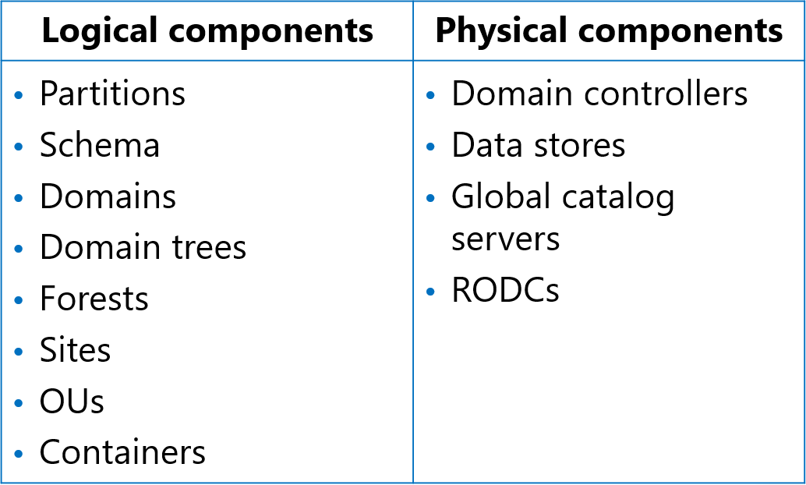
What is Active Directory

Slide 7
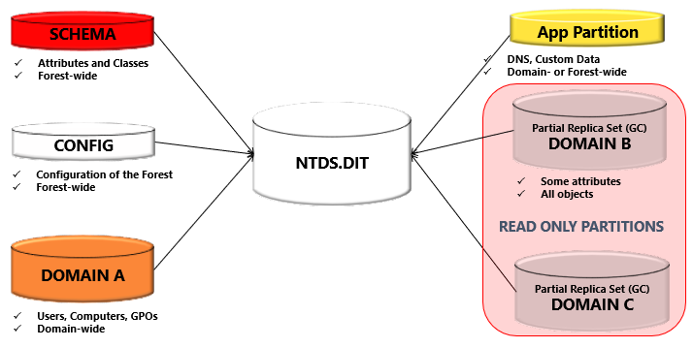
Logical - Partitions

Slide 8
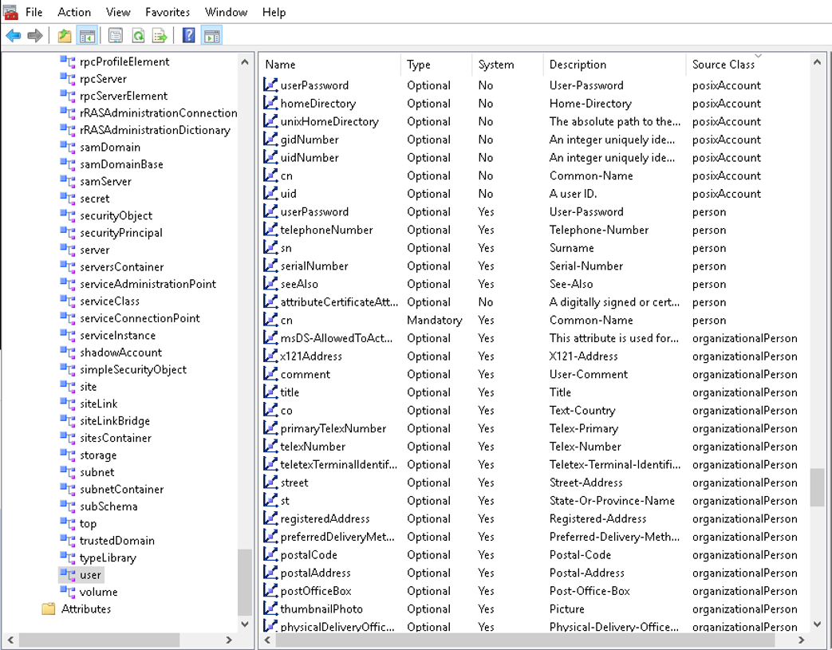
Logical - Schema

Slide 9
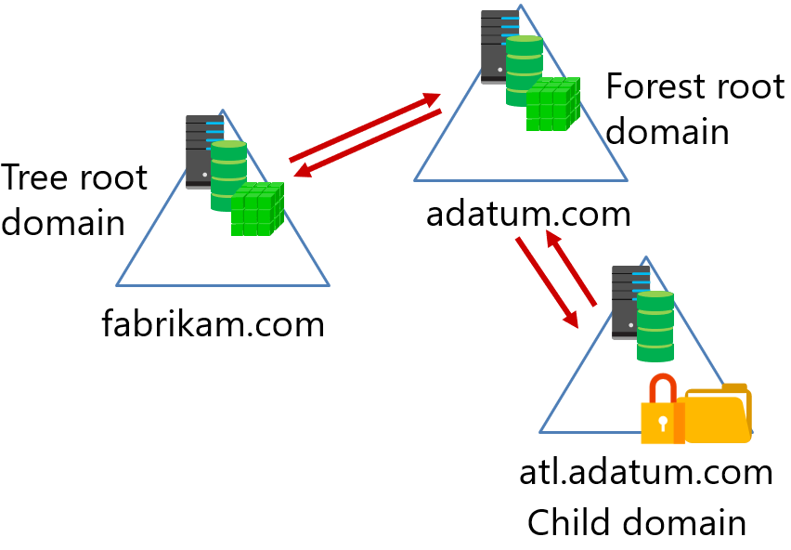
Logical - Names

Slide 10
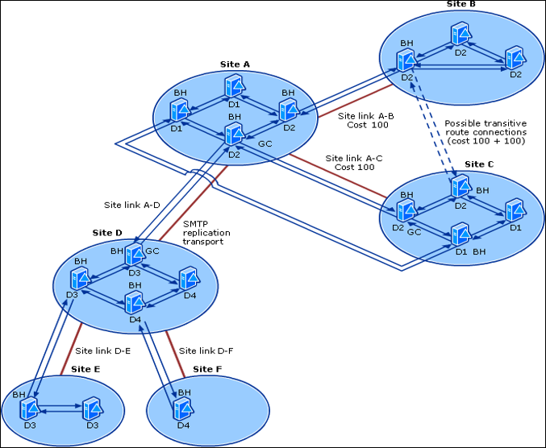
Logical – Sites and Subnets

Slide 11
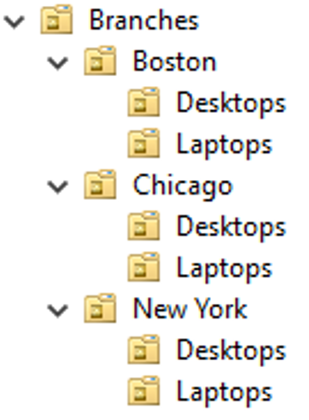
Logical - OUs

Slide 12
Physical – Domain Controllers
Servers that host the AD DS database (ntds.dit) and other supporting service files (like the SYSVOL)
Hosts the service endpoints used by authentication (Kerberos = KDC)
Should be deployed to provide high availability
Always have at least 2 domain controllers in the domain
Should be deployed in secure environments
Use RODCs and BitLocker when not possible
Re-evaluate the need for a DC in an unsecure (physical) location

Slide 13
Physical – Global Catalog

Slide 14


Slide 15
Active Directory Critical Services
Distributed File System Replication (DFSR)
Domain Name System (DNS) client
DNS server
Kerberos Key Distribution Center (KDC)
Netlogon
Windows Time
AD DS (Active Directory Domain Service)
Active Directory Web Services (ADWS)

Slide 16
DFSR Service
Used to replicate the SYSVOL content between DCs
Group Policy and other replication issues occur if the service is interrupted

Slide 17
DNS Client Service
Provides Dynamic DNS registrations for Host A and PTR records on Windows Server 2008 DCs and above
Caching resolved queries and other functions are affected if service is interrupted

Slide 18
DNS Server Service
Provides name resolution for DNS client computers
Common problems include:
Failure to register DNS records
Unable to locate DCs or other key services

Slide 19
Kerberos Key Distribution Center (KDC) Service
Supports Kerberos-based authentication
Service interruptions result in many different authentication issues (logon, trusts, and so on)
Target for any Kerberos Proxy services

Slide 20
Netlogon Service
Maintains secure channel between domain members and DCs, and between DCs in trust
Registers Service Locator records in DNS
Records also written to the Netlogon.DNS file
Service interruptions result in issues with authentication, Kerberos PAC verification, password changes, Dynamic DNS record registration

Slide 21
Netlogon Service cont.
The NetLogon service verifies NTLM logon requests. It registers, authenticates, and locates domain controllers
The Netlogon Remote Protocol RPC interface is used to establish and maintain the secure channel that is used by the members of a domain to communicate with the domain controller
The Netlogon Remote Protocol RPC interface is used to transport authentication requests from domain members to the DC, and among DCs. This functionality is most commonly implemented by authentications using the NTLM Authentication Protocol, but it is also used by other protocols such as Kerberos and Digest

Slide 22
Netlogon Service – yeah, its important!
The Netlogon Remote Protocol RPC interface is used to transmit certain account changes, such as password changes or account lockout information
The Netlogon Remote Protocol serves as its own security provider for its RPC connection. That is, the authentication protocol is used both within the RPC exchanges for specific methods, and also as a general authentication protocol for the entire Netlogon Remote Protocol RPC interface

Slide 23
Windows Time Service (W32Time)
Acts as Network Time Protocol (NTP) client and NTP time server
Critical for time-reliant transactions (Kerberos is a good example)

Slide 24
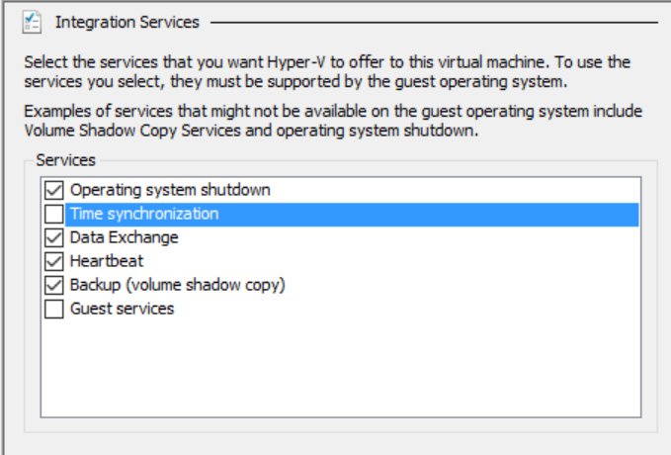
What about W32Time on Virtual DCs?

Slide 25
Active Directory Domain Service (AD DS)
Starting with Windows Server 2008, the service can be stopped and started while the operating system is online
Service interruption prevents all services provided by the DC

Slide 26
Active Directory Web Services (AD WS)
Required for Active Directory Powershell module to work (v2 and v3)
Required for Active Directory Administrative Center to work (starting with Windows Server 2008 R2)
By default, running on any version of DCs starting with Windows Server 2008 R2
Can be installed on older systems as Active Directory Management Gateway Service

Slide 28
FSMO – Fizz-what?! – 5 guys! (who’s hungry)
Five Roles
Provide control over conflicting updates
Automatically assigned
Forest-Wide Roles
Schema Master – Schema Administrators can manage
Domain Naming Master – Enterprise Administrators can manage
Domain-Wide Roles
PDC Emulator – Domain Administrators can manage
RID Master – Domain Administrators can manage
Infrastructure Master (IM) - Domain Administrators can manage

Slide 29
Forest-Wide Operations Master Roles
Schema Master
All schema changes governed here
Changed recommendation – always have the most up-to-date schema version even if you do not plan to upgrade in the near future
Domain Naming Master
Performs domain add/delete requests
Manages crossRef objects in Partitions container
Prepares domain rename operations

Slide 30
Domain-Wide Operations Master Roles
RID Master
Relative Identifier Allocator
Every security principal created needs a RID
RID conflicts result in duplicate SIDs
Windows Server 2012 added improvements for RID Master
Periodic Consumption Warnings
RID Pool Invalidation Events
RID Block Size Cap
Global RID Space Size Unlock
RID Ceiling Enforcement
Notes:
RID Master
The Relative Identifier, or RID, operations master allocates blocks of 500 RIDs to each domain controller in the domain. When a domain controller creates a new Security principal, such as a user, group or computer object, it assigns a unique Security Identifier (SID) to the object. This SID consists of a domain SID, which is the same for all security principals created in the domain, and an RID, which uniquely identifies each security principal created in the domain.
Windows Server 2012 Improvements
By default, a domain has the capacity for roughly one billion security principals, such as users, security groups, managed service accounts, and computers. If you run out, you cannot create any more.
There are not any domains with that many active objects, of course, but we have seen:
Provisioning software or administrative scripts accidentally bulk created users, groups, and computers
Many unused security and distribution groups created by delegated users
Many domain controllers demoted, restored, or metadata cleaned
Forest recoveries with an inappropriately set lower RID pool
The InvalidateRidPool operation performed too frequently
The RID Block Size registry value increased incorrectly
RID Master seized
All of these situations use up RIDs unnecessarily, often by mistake. Over many years, a few environments ran out of RIDs and this forced customers to migrate to a new domain or revert with domain and forest recoveries.
Windows Server 2012 addresses issues with the RID allocation that have become more likely with the age and ubiquity of Active Directory. These include better event logging, more appropriate limits, and the ability to—in an emergency—increase the overall RID pool allocation by one bit.
Periodic Consumption Warnings
Windows Server 2012 adds global RID space event tracking that provides early warning when major milestones are crossed. The model computes the ten (10) percent used mark in the global pool and logs an event when reached. Then it computes the next ten percent used of the remaining and the event cycle continues. As the global RID space is exhausted, events will accelerate as ten percent hits faster in a decreasing pool (but event log dampening will prevent more than one entry per hour). The System event log on every domain controller writes Directory-Services-SAM warning event 16658.
Assuming a default 30-bit global RID space, the first event logs when allocating the pool containing the 107,374,182ND RID. The event rate accelerates naturally until the last checkpoint of 100,000, with 110 events generated in total. The behavior is similar for an unlocked 31-bit global RID space: starting at 214,748,365 and completing in 117 events.
RID Pool Invalidation Events
There are new event alerts that a local DC RID pool was discarded. These are Informational and could be expected, especially due to the new virtualized domain controller functionality. See the event list later for details on the event.
RID Block Size Cap
Ordinarily, a domain controller requests RID allocations in blocks of 500 RIDs at one time. You can override this default using the following registry REG_DWORD value on a domain controller:
HKEY_LOCAL_MACHINE\SYSTEM\CurrentControlSet\Services\NTDS\RID Values RID Block Size
Prior to Windows Server 2012, there was no maximum value enforced in that registry key, except the implicit DWORD maximum (which has a value of 0xffffffff or 4294967295). This value is considerably larger than the total global RID space. Administrators sometimes inappropriately or accidentally configured RID Block Size with values that exhausted the global RID at a massive rate.
In Windows Server 2012, you cannot set this registry value higher than 15,000 decimal (0x3A98 hexadecimal). This prevents massive unintended RID allocation.
If you set the value higher than 15,000, the value is treated as 15,000 and the domain controller logs event 16653 in the Directory Services event log at every reboot until the value is corrected.
Global RID Space Size Unlock
Prior to Windows Server 2012, the global RID space was limited to 2³⁰ (or 1,073,741,823) total RIDs. Once reached, only a domain migration or forest recovery to an older timeframe allowed new SIDs creation - disaster recovery, by any measure. Starting in Windows Server 2012, the 2³¹ bit can be unlocked in order to increase the global pool to 2,147,483,647 RIDs.
AD DS stores this setting in a special hidden attribute named SidCompatibilityVersion on the RootDSE context of all domain controllers. This attribute is not readable using ADSIEdit, LDP, or other tools. To see an increase in the global RID space, examine the System event log for warning event 16655 from Directory-Services-SAM or use the following Dcdiag command:
Dcdiag.exe /TEST:RidManager /v | find /i "Available RID Pool for the Domain"
If you increase the global RID pool, the available pool will change to 2,147,483,647 instead of the default 1,073,741,823
RID Ceiling Enforcement
To afford a measure of protection and elevate administrative awareness, Windows Server 2012 introduces an artificial ceiling on the global RID range at ten (10) percent remaining RIDs in the global space. When within one (1) percent of the artificial ceiling, the domain controller requesting RID pools write Directory-Services-SAM warning event 16657 to their System event log. When reaching the ten percent ceiling on the RID Master FSMO, it writes Directory-Services-SAM event 16657 to its System event log and will not allocate any further RID pools until overriding the ceiling. This forces you to assess the state of the RID Master in the domain and address potential runaway RID allocation; this also protects domains from exhausting the entire RID space.
This ceiling is hard-coded at ten percent remaining of the available RID space. That is, the ceiling activates when the RID master allocates a pool that includes the RID corresponding to ninety (90) percent of the global RID space.
For default domains, the first trigger point is 2³⁰-1 * 0.90 = 966,367,640 (or 107,374,183 RIDs remaining).
For domains with an unlocked 31-bit RID space, the trigger point is 2³¹-1 * 0.90 = 1,932,735,282 RIDs (or 214,748,365 RIDs remaining).
You can hit this event twice in the lifetime of a domain - once with a default-sized RID pool and once when you unlock. Preferably never, of course.
When triggered, the RID Master sets Active Directory attribute msDS-RIDPoolAllocationEnabled (common name ms-DS-RID-Pool-Allocation-Enabled) to FALSE on the object:
CN=RID Manager$,CN=System,DC=<domain>
This writes the 16657 event and prevents further RID block issuance to all domain controllers. Domain controllers continue to consume any outstanding RID pools already issued to them.
To remove the block and allow RID pool allocation to continue, set that value to TRUE. On the next RID allocation performed by the RID Master, the attribute will return to its default NOT SET value. After that, there are no further ceilings and eventually, the global RID space runs out, requiring forest recovery or domain migration.

Slide 31
Domain-Wide Operations Master Roles
PDC Emulator
Down-level NT PDC (don’t ask – we screwed that up!)
Processes password changes
Authoritative time source for domain
Group Policy Master
Default target for GPMC updates to Group Policies
Required for DC cloning in Windows Server 2012 (as in, it needs to be at least Windows Server 2012)
Notes:
PDC Emulator
The PDC emulator operations master acts as a Windows NT PDC in domains that contain client computers operating without Active Directory client software or Windows NT Backup Domain Controllers (BDC). In addition, the PDC emulator processes password changes from clients and replicates the updates to the Windows NT BDCs. Even after all domain controllers are upgraded to Windows 2000 Server or Windows Server 2003 or Windows Server 2008, the PDC emulator receives preferential replication of password changes performed by other domain controllers in the domain. If a logon authentication fails at another domain controller because a bad password is used, that domain controller forwards the authentication request to the PDC emulator before rejecting the logon attempt.
Authoritative Time Source
Primary Domain Controller Emulator PDC (e) is the server FSMO (Flexible Single Master Operation) role that is responsible for time synchronization in the domain and the forest. The PDC(e) of the Forest Root Domain uses Network Time Protocol and should be pointed to a very reliable time source, typically a hardware device or trusted time source on the Internet, such as those used by the scientific community or by government. The two main commands used to configure time synchronization are w32tm .exe (used with Windows Server 2003/Windows Server 2008 and Windows XP) and Net Time.
DC Cloning
Until now, cloning, snapshotting, copying, or pretty much doing anything but rebuilding from scratch to a virtual domain controller was not just unsupported; it had the potential to be really bad for your directory. Cloning or restoring snapshots of domain controllers could result in USN rollbacks or lingering objects, just to name a couple of problems.
Starting in Windows Server 2012, we now support DC cloning as well as snapshot restoration of domain controllers. But there are few catches:

Slide 32
Domain-Wide Operations Master Roles
Infrastructure Master
Updates object references for objects in its domain from other domains
Changes include
Inter and Intra-domain moves
Object deletion
Special Case: Active Directory Recycle Bin Enabled
Notes:
Infrastructure Master
The Infrastructure Operations Master is responsible for updating object references, referred to as "Phantom Objects" in its domain that point to the object in another domain. The Infrastructure Master updates object references locally and uses replication to bring all other replicas of the domain up to date. The object reference contains the object’s Globally Unique Identifier (GUID), distinguished name, and possibly an SID. The distinguished name and SID on the object reference are periodically updated to reflect the changes made to the actual object. These changes include moves within and between domains, as well as the deletion of the object. If the infrastructure master is unavailable, updates to object references are delayed until it comes back online.
Recycle Bin
When the Recycle Bin optional feature is not enabled, the Infrastructure FSMO role owner is the DC responsible for updating a cross-domain object reference in the event that the referenced object is moved, renamed, or deleted. In this case, the Infrastructure Master role should be held by a DC that is not a GC server. If the Infrastructure Master runs on a GC server, it will not update object information, because it does not contain any references to objects that it does not hold. This is because a GC server holds a partial replica of every object in the forest.
When the Recycle Bin optional feature is enabled, every DC is responsible for updating its cross-domain object references in the event that the referenced object is moved, renamed, or deleted. In this case, there are no tasks associated with the Infrastructure FSMO role, and it is not important which DC owns the Infrastructure Master role.

Slide 33
Other FSMO Dependencies
Active Directory Replication
Changes to FSMO roles must replicate through standard Active Directory replication
If replication fails, some DCs will not be aware of the changes
Domain Name System (DNS)
If DNS is not working properly, operations masters cannot be contacted
Initial Synchronization (InitSync)
DCs try to replicate inbound changes at startup
Ensures that FSMO ownership is up-to-date
Notes:
Active Directory Replication
Operations masters replicate changes made on them throughout the domain or forest, depending on whether they hold domain roles or forest roles. Active Directory replication must be working properly in order for the other DCs to receive these changes.
Domain Name System (DNS)
Active Directory requires that DNS is properly designed and deployed, so that DCs can correctly resolve DNS names of replication partners. If DNS is not working properly, operations masters cannot be contacted to perform their specific domain or forest functions.
InitSync
On Microsoft Windows 2000 Server SP3 or later, the DCs that host the operations master roles must successfully replicate inbound changes on the directory partition that replicates and maintains the operations master role's state. Successful replication must occur before dependent operations can be performed. This is done to ensure that the FSMO owner is up-to-date with any changes to the attribute that holds the information about the current FSMO owner. If this attribute was changed while it was offline, it will resign the FSMO ownership. If it is still pointing to the local DC, it will begin acting as the role owner.

Slide 34
Did I mention that FSMOs are SPECIAL?
FSMO | If Role is unavailable | Returning Back After Seizure
Schema master | Cannot make changes to the schema. | Not recommended. Can lead to a corrupted forest.
Domain Naming master | Cannot add or remove domain, application directory partitions, crossRef objects and perform domain rename operations. | Not recommended. Can lead to data corruption.
RID master | Cannot create new directory objects, when DC’s individual RID pool is depleted. | Not recommended. Can lead to data corruption.
PDC emulator | Different issues with password changes, AdminSDHolder process, DFS Namespaces administration, etc. | Allowed. User authentication can be erratic for a time, but no permanent damage occurs.
Infrastructure master | Delays displaying updated group membership lists. | Allowed. May impact the performance of the domain controller hosting the role, but no damage occurs to the directory.

Slide 35
Users – why do you treat me like an object?!
Users accounts:
Allow or deny access to sign into computers
Grant access to processes and services
Manage access to network resources
User accounts can be created by using:
Active Directory Users and Computers
Active Directory Administrative Center
Windows PowerShell
Considerations for naming users include:
Naming formats
UPN suffixes

Slide 36
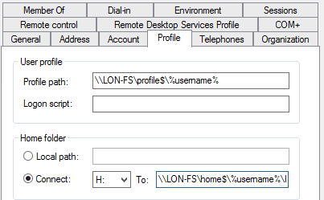
User Properties
Account
Organization
Member of
Password Settings
Profile
Policy
Silo
Extensions

Slide 37
Users – should be fresh!
Users accounts that will be inactive for a period of time should be disabled rather than deleted
To disable an account in Active Directory Users and Computers, right-click the account and click Disable Account from the menu

Slide 39
Groups – this may get confusing…
There are 2 types
There are 4 scopes
There are some default groups
There are some “special” identities

Slide 40

Group Types
Distribution groups
Used only with email applications
Not security enabled (no SID)
Cannot be given permissions
Security groups
Security principal with a SID
Can be given permissions
Can also be email-enabled
You can convert security groups to distribution groups and distribution groups to security groups

Slide 41
Group Scopes
Local - can contain users, computers, global groups, domain-local groups and universal groups from the same domain, domains in the same forest and other trusted domain and can be given permissions to resources on the local computer only
Domain-local - have the same membership possibilities as Local but can be given permission to resources anywhere in the domain
Universal - can contain users, computers, global groups and other universal groups from the same domain or domains in the same forest and can be given permissions to any resource in the forest
Global - can only contain users, computers and other global groups from the same domain and can be given permission to resources in the domain or any trusted domain

Slide 42



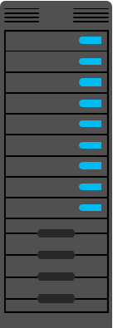

Groups – Nesting: IGDLA Best Practice
I: Identities, users, or computers, which are members of
G: Global groups, which collect members based on members’ roles, which are members of
DL: Domain-local groups, which provide management such as resource access which are
A: Assigned access to a resource
Sales
(global group)
Auditors
(global group)
ACL_Sales_Read (domain-local group)

Slide 43

OR…
Sales
(global group)
Auditors
(global group)

Slide 44
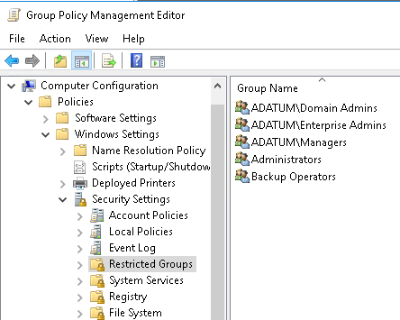
Restricting Groups

Slide 45
Default Groups
Group | Location
Enterprise Admins | Users container of the forest root domain
Schema Admins | Users container of the forest root domain
Administrators | Built-in container of each domain
Domain Admins | Users container of each domain
Server Operators | Built-in container of each domain
Account Operators | Built-in container of each domain
Backup Operators | Built-in container of each domain
Print Operators | Built-in container of each domain
Cert Publishers | Users container of each domain

Slide 46
Special identities:
Are groups for which the operating system controls membership
Can be used by the Windows Server operating system to provide access to resources based on the type of authentication or connection, not on the user account
Important special identities include:
Anonymous Logon Authenticated Users Everyone | Interactive Network Creator Owner

Slide 48
Computer Accounts – not always happy
Computers have accounts:
SAMAccountName and password
Used to create a secure channel between the computer and a domain controller
Scenarios in which a secure channel might be broken:
Reinstalling a computer, even with same name, generates a new SID and password
Restoring a computer from an old backup or rolling back a computer to an old snapshot
The computer and domain disagreeing about what the password is

Slide 49
Computers – this shouldn’t be confusing ☺
All computers have a distinguished name – just like any other object
Relative names have to be unique
OU strategy plays an important role with Computer objects
Best practice is to create OUs for computer objects
Servers are typically subdivided by server role
Client computers are typically subdivided by region

Slide 50
OU Hierarchy Considerations
Align OU strategy to administrative requirements, not the organizational chart, because organizational charts are more subject to change than your IT administration model
AD DS inheritance behavior can simplify Group Policy administration because it allows group polices to be set on an OU and flow down to lower OUs in the hierarchy
Plan to accommodate changes in the IT administration model

Slide 52

AD DS Partitions (review)
Configuration
Forest-wide information about the AD DS structure
Forest-wide definitions and rules for creating and manipulating objects and attributes
Schema
Information about domain-specific objects
Domain
Information about applications
Application
AD DS database

Slide 53
Characteristics (part 1)
Multi-master replication ensures:
Accuracy (integrity)
Consistency (convergence)
Performance (keeping replication traffic to a reasonable level)

Slide 54
Characteristics (part 2)
Key characteristics of AD DS replication include:
Multi-master replication
Pull replication
Store-and-forward replication
Partitions
Automatic generation of an efficient, robust replication topology
Attribute-level and multivalue replication
Distinct control of intersite replication
Collision detection and management

Slide 55
Intrasite Replication Uses:
Connection objects for inbound replication to a domain controller
Knowledge Consistency Checker to automatically create a topology that is efficient (maximum three-hop) and robust (two-way)
Notifications in which the domain controller tells its downstream partners that a change is available
Polling, in which the domain controller checks with its upstream partners for changes:
Downstream domain controller directory replication agent replicates changes
Changes to all partitions held by both domain controllers are replicated

Slide 56
Intrasite Conflict Resolution
In multi-master replication models, replication conflicts arise when:
The same attribute is changed on two domain controllers simultaneously
An object is moved or added to a deleted container on another domain controller
Two objects with the same relative distinguished name are added to the same container on two different domain controllers
To resolve replication conflicts, AD DS uses:
Version number
Time stamp
Server GUID

Slide 57

Global
catalog
server
A1
A2
B2
B2
B1
B1
Domain
controllers in another
domain
Global
catalog
server
A3
A3
A4
A4
B3
Domain A topology
Global
catalog
server
B3
Domain B topology
Schema and configuration topology
Global catalog replication

Slide 58
AD DS Sites
Sites identify network locations with fast, reliable network connections
Sites are associated with subnet objects
Sites are used to manage:
Replication when domain controllers are separated by slow, expensive links
Service localization:
Domain controller authentication
AD DS–aware (site-aware) services or applications
A1
A2
Site A
Site B

Slide 59
Intersite Replication
Assumes higher cost, limited bandwidth, and unreliable network links
Has the ability to compress replication
Occurs on a configured schedule
Can be configured for immediate and urgent replications

Slide 60
What’s the ISTG?
ISTG defines the replication between
AD DS sites on a network
Replication
ISTG
Replication
ISTG
Site link

Slide 62
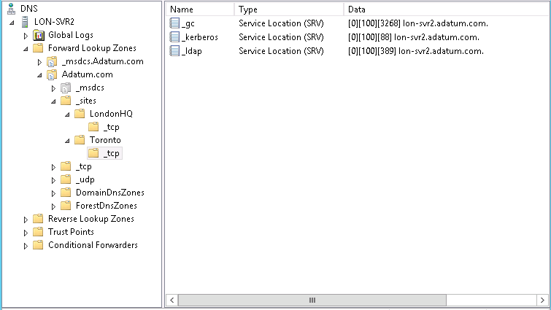
Sites and DNS
Domain controllers register SRV records as follows:
_tcp.adatum.com: All domain controllers in the domain
_tcp.sitename._sites.adatum.com: All services in a specific site
Clients query DNS to locate services in specific sites

Slide 63
So THAT’s how I find a DC! (normally)
The new client queries for all domain controllers in the domain
The client attempts an LDAP ping to find all domain controllers
First domain controller responds
The client queries for all domain controllers in the site
The client attempts an LDAP ping to find all domain controllers in the site
The client forms an affinity (NOT an infinity!)

Slide 64



Site Links
Within a site link, a connection object can be created between any two domain controllers
The default site link, DEFAULTIPSITELINK, is not always appropriate with your network topology
SEA
SEA
HQ-SEA
Site-link
BEIJING
AMS
BEIJING
HQ
HQ
AMS
DEFAULTIPSITELINK

Slide 66
Group Policy
A form of configuration management
Configuration management is a centralized approach to applying one or more changes to more than one user or computer
The key elements of configuration management are:
Setting
Scope
Application

Slide 67
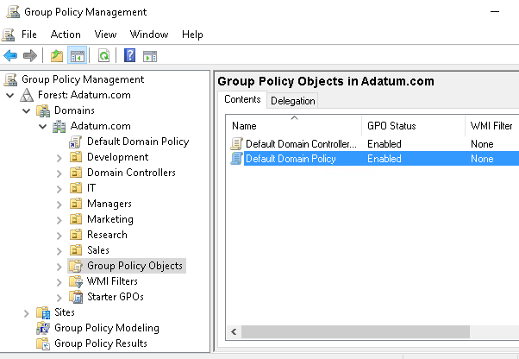
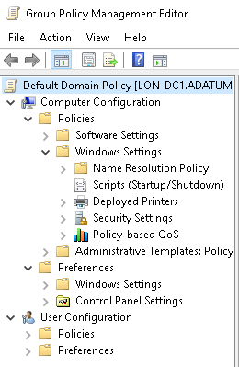
Group Policy Tools
Group Policy Management Console
Group Policy Management Editor

Slide 68
Why Use Group Policy?
Group Policy is a very powerful administrative tool
You can use it to enforce various types of settings to a large number of users and computers
Typically, you use GPOs to:
Apply security settings
Manage desktop application settings
Deploy application software
Manage Folder Redirection
Configure network settings

Slide 69
Group Policy Objects (GPO)
A container for one or more policy settings
Managed with the GPMC
Stored in the GPOs container
Edited with Group Policy Management Editor
Applied to a specific level in the AD DS hierarchy

Slide 70
GPO Scope
The scope of a GPO is the collection of users and computers that will apply the settings in the GPO
You can use several methods to scope a GPO:
Link the GPO to a container, such as an OU
Filter by using security settings
Filter by using WMI filters
For Group Policy preferences:
You can filter or target the settings that you configure by Group Policy preferences within a GPO based on several criteria

Slide 71
GPO Application (Processing Order)
Local GPOs
Site-level GPOs
Domain-level GPOs
OU GPOs, including any nested OUs

Slide 72
GPO Application Process
Group Policy application process:
Group Policy Client retrieves GPOs
Client downloads and caches GPOs
Client-side extensions process the settings
Policy settings in the Computer Configuration node apply at system startup and every 90–120 minutes thereafter
Policy settings in the User Configuration node apply at sign-in and every 90–120 minutes thereafter

Slide 73

GPO – a dissection
Group Policy container
GPO
Stored in AD DS
Provides version information
Group Policy template
Contains Group Policy settings
Stores content in two locations
Stored in shared SYSVOL folder
Provides Group Policy settings

Slide 74
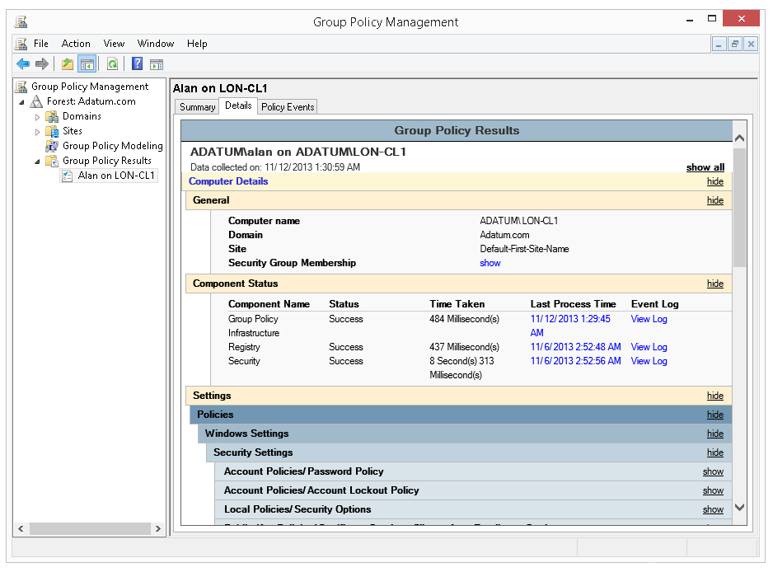
RSoP
RSoP is the net effect of GPOs applied to a user or computer

Slide 76
Active Directory Sizing/Capacity
Why plan?
Properly implement and operate an environment
Reduce the time and cost to troubleshoot (performance) issues
What you want to consider:
64-bit (everything) platforms – NO 32-bit requirements
Virtualization
Increased attention to power consumption
SSD/NVMe storage
Cloud scenarios
Notes:
https://social.technet.microsoft.com/wiki/contents/articles/14355.capacity-planning-for-active-directory-domain-services.aspx

Slide 77
The Basics of More
Memory
Network
Storage
Processor
Netlogon (speed and capacity)

Slide 78
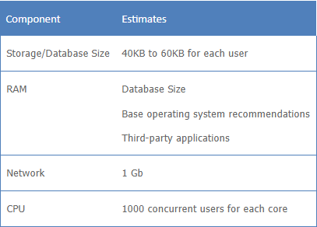
Assumptions

Slide 79
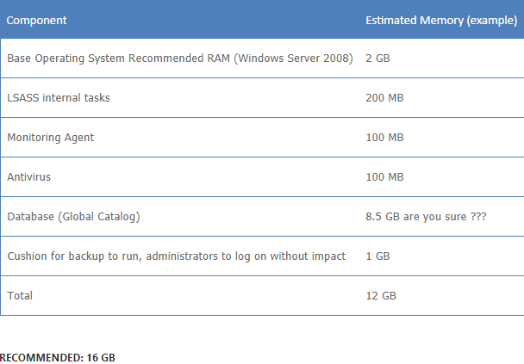
Memory - Sample

Slide 80
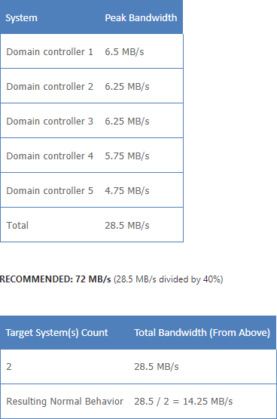
Network - Sample

Slide 81
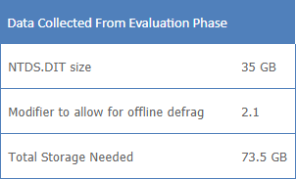
Storage - Sample

Slide 82
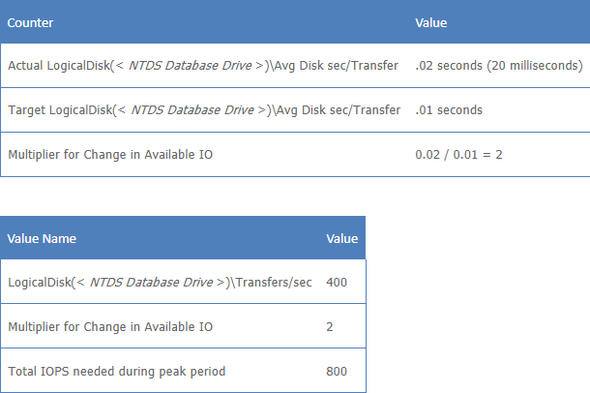
Storage Performance - Sample

Slide 83
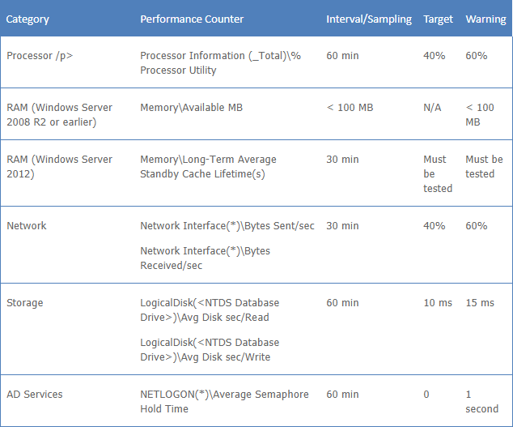
Capacity Goals - Sample

Slide 84
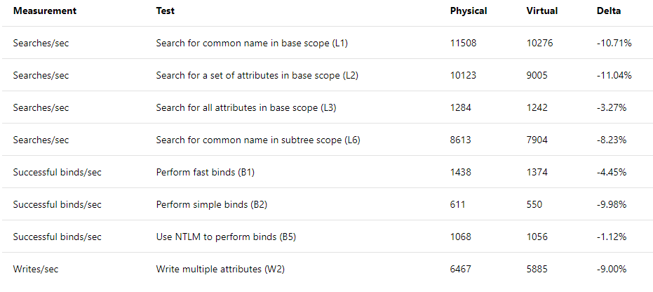
Virtualization Impacts
Notes:
https://docs.microsoft.com/en-us/windows-server/identity/ad-ds/get-started/virtual-dc/virtualized-domain-controllers-hyper-v

Slide 85
Virtual DC Rules (thou shalt nots)
Pause/stop/store saved states of a virtual DC
Copy or clone virtual hard disks of a virtual DC
Take snapshots
Use differencing disks
Export a virtual DC VM
Restore a virtual DC using any of the above methods
Sync time with the virtual host (hypervisor)

Slide 86
Active Directory Security
Know the “avenues of compromise”
Reduce the Active Directory Attack Surface
Monitor Active Directory for “signs of compromise” (IOC)
Plan for Compromise (practice DR)
Notes:
https://docs.microsoft.com/en-us/windows-server/identity/ad-ds/plan/security-best-practices/best-practices-for-securing-active-directory

Slide 87
Avenues of Compromise
Initial breach targets
Gaps in antivirus and antimalware deployments
Incomplete patching
Outdated applications and operating systems
Misconfiguration
Lack of secure application development practices
Credential Theft
Risky account activities
Privilege elevation

Slide 88
Reducing the Attack Surface
Limit or Remove privilege
Implement Least Privilege Administrative Models
Tier Model
Service isolation
Implement Secure Administrative Hosts
PAWs
Never administer trusted systems from untrusted hosts

Slide 89
Monitor for IOC
Audit Activities
Audit Policies
Network Monitoring

Slide 90
Plan for Compromise
Maintain a Secure Environment
Identify and Isolate critical assets
Implement “creative-destruction” ☺
Isolate legacy systems and applications
Simplify end user security

Slide 91
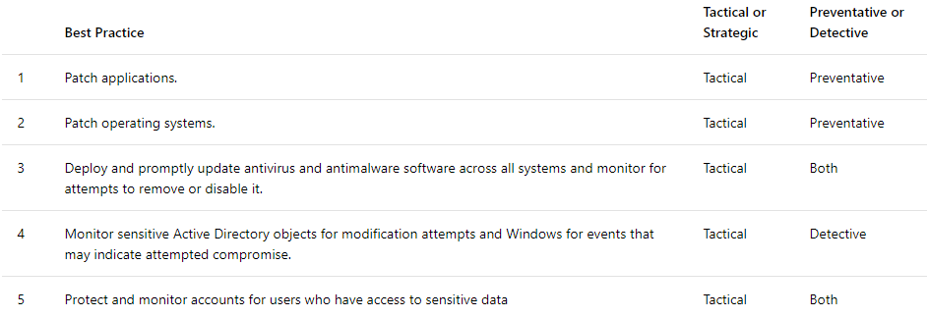
ADS Top 10 (I really mean 22)

Slide 92
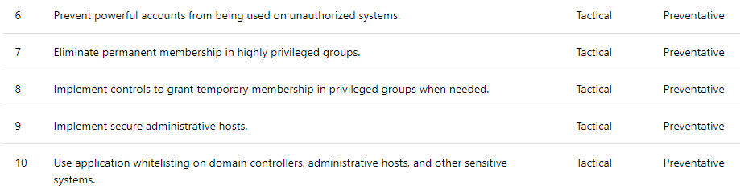
ADS Top 10 (I really mean 22)

Slide 93
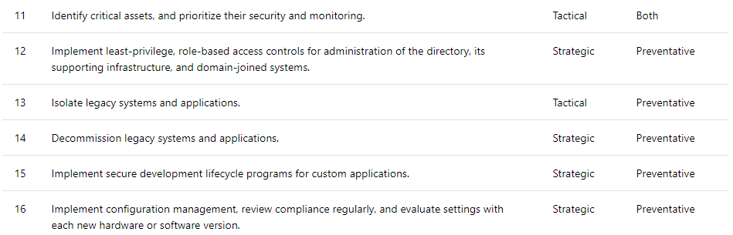
ADS Top 10 (I really mean 22)

Slide 94
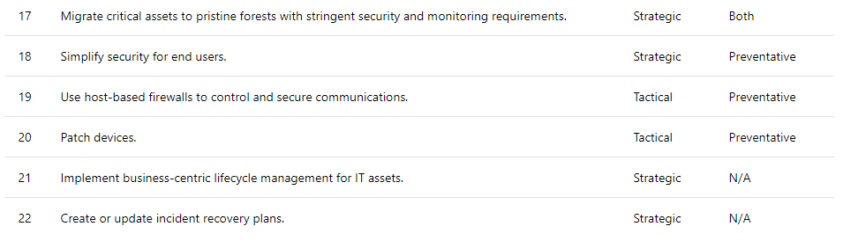
ADS Top 10 (I really mean 22)

Slide 95
Applying Baselines
OS and Version specific
Offered by Microsoft for FREE
Can also use 3rd party sources
CIS L1 – very close to Microsoft reference
CIS L2 – cares nothing about your need to use the OS, but it IS secured
NIST/STIG – government/military application requirements

Slide 97
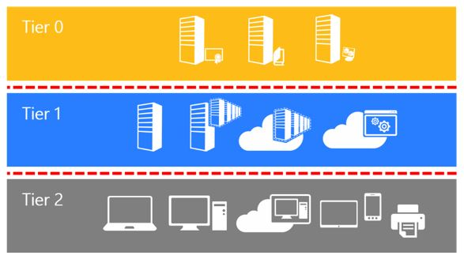
Active Directory Admin Tier Model
Notes:
https://docs.microsoft.com/en-us/windows-server/identity/securing-privileged-access/securing-privileged-access-reference-material#ADATM_BM

Slide 98
Tier 0 (zero)
Direct Control of enterprise identities in the environment.
Tier 0 includes accounts, groups, and other assets that have direct or indirect administrative control of the Active Directory forest, domains, or domain controllers, and all the assets in it.
The security sensitivity of all Tier 0 assets is equivalent as they are all effectively in control of each other.

Slide 99
Tier 1
Control of enterprise servers and applications.
Tier 1 assets include server operating systems, cloud services, and enterprise applications.
Tier 1 administrator accounts have administrative control of a significant amount of business value that is hosted on these assets.
A common example role is server administrators who maintain these operating systems with the ability to impact all enterprise services.

Slide 100
Tier 2
Control of user workstations and devices.
Tier 2 administrator accounts have administrative control of a significant amount of business value that is hosted on user workstations and devices.
Examples include Help Desk and computer support administrators because they can impact the integrity of almost any user data.

Slide 101
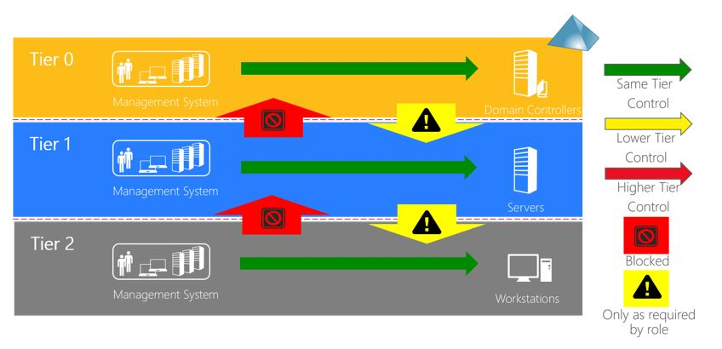
Control Restrictions

Slide 102
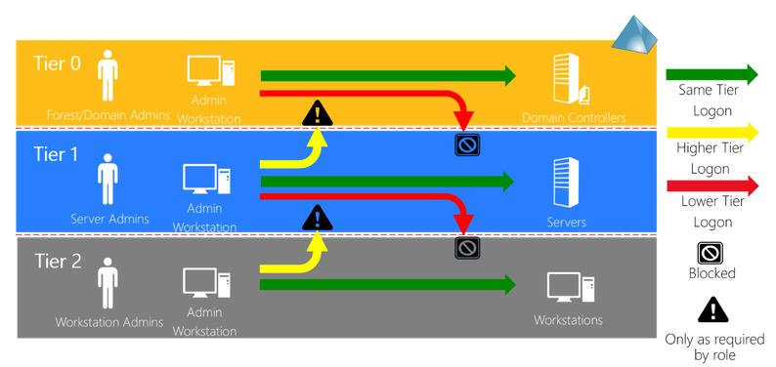
Logon Restrictions

Slide 103
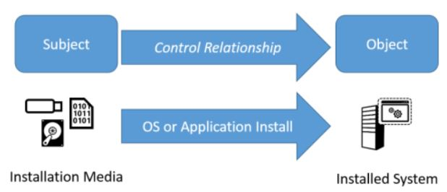
Clean Source

Slide 104
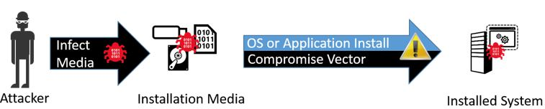
But why…?!

Slide 105
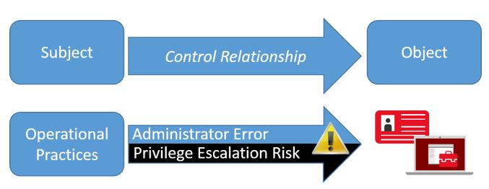
Operational Standards based on Clean Source

Slide 106
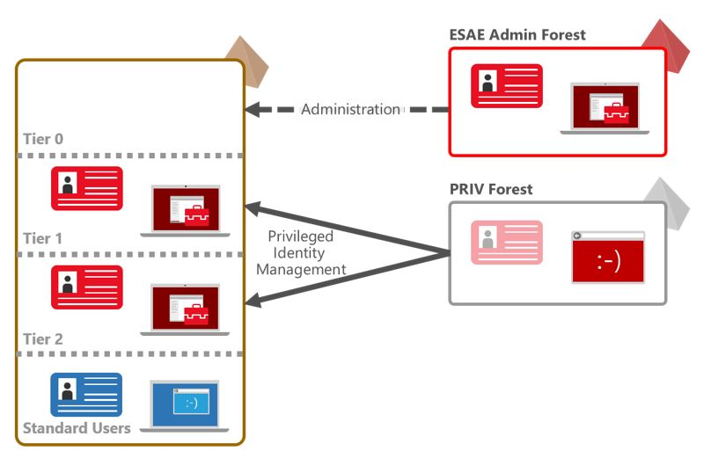
Enhanced Security Admin Environment

Slide 107
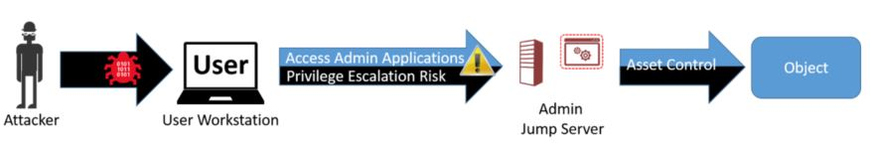
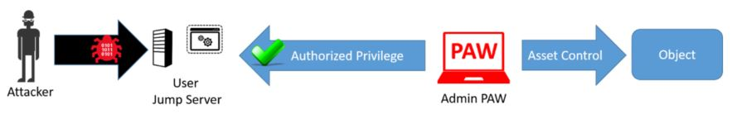
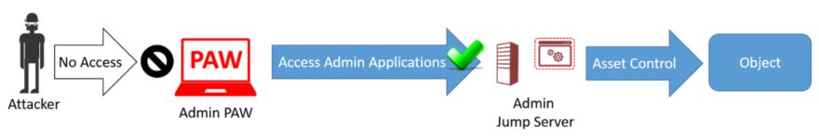
Privileged Admin Workstation (PAW)
Notes:
https://docs.microsoft.com/en-us/windows-server/identity/securing-privileged-access/privileged-access-workstations
https://docs.microsoft.com/en-us/windows-server/identity/securing-privileged-access/securing-privileged-access-reference-material

